Slide 1
Timers
Time Outs | Intervals
Notes:
Welcome to our lecture on timers in JavaScript. In this lecture we will go through time outs and intervals. Let’s start our lecture.

Slide 2
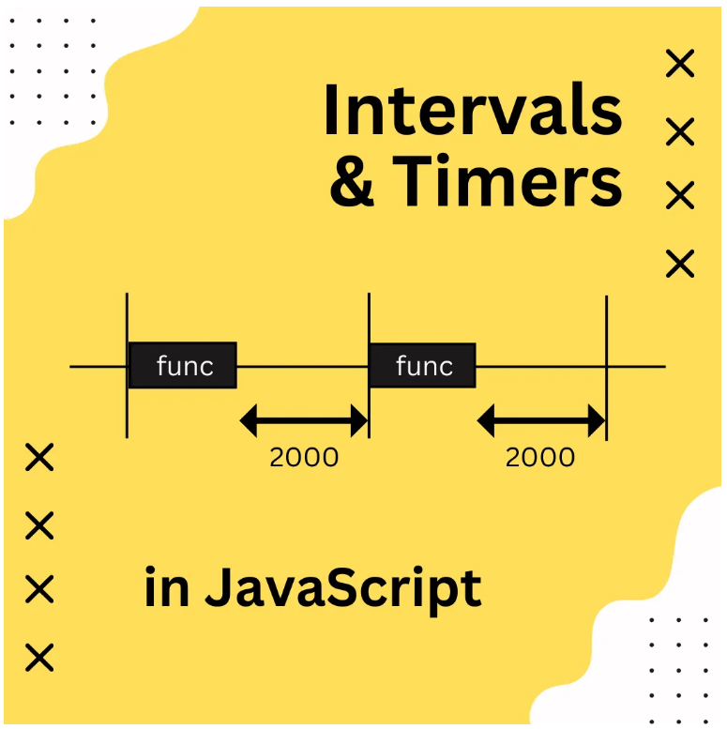
Timeouts
Time-Based Events: Some events occur after a delay, like showing ads or updating inventory periodically.
Using setTimeout(): Executes a function after a specified delay (in milliseconds) and returns an identifier.
Canceling a Timeout: The clearTimeout() method stops a scheduled timeout using its identifier.
Notes:
JavaScript provides time-based event handling using set Timeout and clear Timeout. Some events occur after a delay, like displaying ads or updating data. The set Timeout function runs a specified function after a given delay in milliseconds and returns an identifier. To cancel a scheduled timeout before it executes, we use clear Timeout with the timeout identifier, ensuring better control over delays.

Slide 3
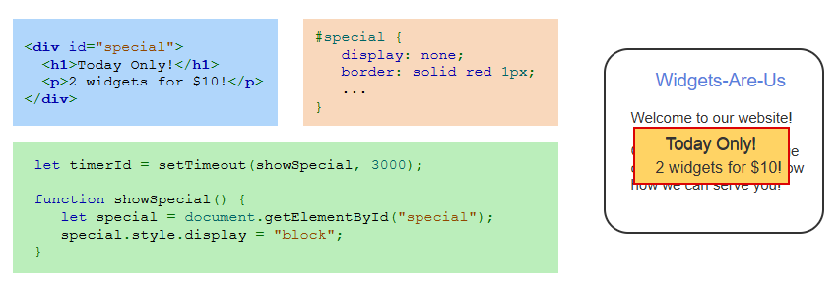
Example
Notes:
This example demonstrates the use of set Timeout in JavaScript. The special message starts hidden using CSS. A JavaScript function, triggered by set Timeout, changes the display style to block after three seconds, making the message appear. This approach is useful for showing delayed notifications or promotions on a webpage, ensuring timed visibility for important content.

Slide 4
Intervals
Using setInterval(): Executes a function repeatedly at a specified interval (in milliseconds).
Continuous Execution: The function runs every t milliseconds until stopped.
Canceling an Interval: The clearInterval() method stops a running interval using its identifier.
Notes:
Finally, we will discuss intervals. JavaScript provides set Interval to execute a function repeatedly at a specified time interval. The function runs continuously until stopped, making it useful for tasks like updating a clock or fetching live data. To stop an interval, we use clear Interval with the interval's identifier. Understanding these methods helps in managing time-based operations effectively in web applications.

Slide 5
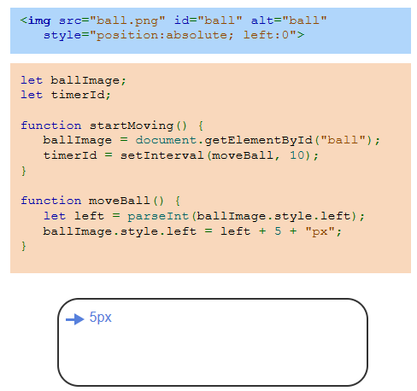
Example
Notes:
This example demonstrates how set Interval is used to animate an element in JavaScript. The ball image starts at the leftmost position, and a function moves it 5 pixels to the right every 10 milliseconds. The set Interval method repeatedly calls the move Ball function, updating the position smoothly. This technique is useful for simple animations and dynamic movement in web applications. Thanks for watching the lecture.

